Slide 1
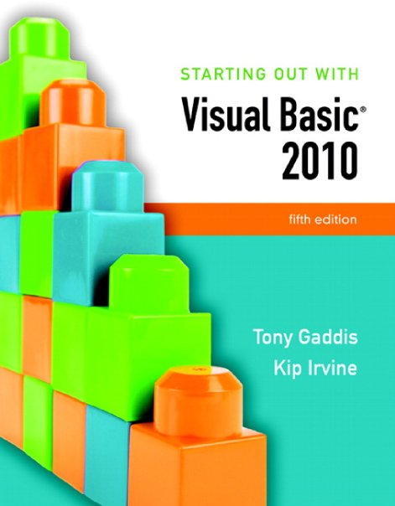

Slide 2
Chapter 6
Procedures and Functions

Slide 3
Introduction
A procedure is a collection of statements that performs a task
Event handlers are a type of procedure
A function is a collection of statements that performs a task and returns a value to the part of the program that executed it
You have already worked with Visual Basic’s built-in functions, such as CInt and IsNumeric
A method can be either a procedure or a function

Slide 4
Procedures
Section 6.1
You can write your own general purpose procedures that perform
specific tasks. General purpose procedures are not triggered by
events, but are called from statements in other procedures.

Slide 5
Procedure Uses
An event handler is a type of procedure
Automatically executed when an event such as a mouse click occurs
General purpose procedures are triggered by statements in other procedures, not by events
Procedures help simplify & modularize code by:
Breaking it into small, manageable pieces
Performing a task that is needed repeatedly
Dividing a program into a set of logical tasks
Tutorial 6-1 examines an application with a procedure

Slide 6
Declaring a Procedure
The general format of a procedure declaration is as follows:
AccessSpecifier is optional and establishes accessibility to the program
Sub and End are keywords
ProcedureName used to refer to procedure
Use Pascal casing to capitalize 1st character of the name and each new word in the name
ParameterList is a list of variables or values being passed to the sub procedure
Tutorial 6-2 guides you through the process of writing procedures
[AccessSpecifier] Sub ProcedureName ([ParameterList])
[Statements]
End Sub

Slide 7
Static Local Variables
Variables needed only in a procedure, should be declared within that procedure
Creates a local variable with scope only within the procedure where declared
Local variable values are not saved from one procedure call to the next
To save value between procedure calls, use Static keyword to create a static local variable
Scope is still only within the procedure
But variable exists for lifetime of application
Static VariableName As DataType

Slide 8
Passing Arguments to Procedures
Section 6.2
When calling a procedure, you can pass it values known as
arguments.

Slide 9
Arguments
An Argument is value passed to a procedure
For example:
Calls the CInt function
Passes txtInput.Text as an argument
Two ways to pass arguments
by value is a temporary copy of the original argument
by reference is the original argument and can be changed
CInt(txtInput.Text)

Slide 10
Passing Arguments By Value
intNumber declared as an integer argument
Storage location intNumber created by procedure
A value, 5 in this case, must be supplied and is copied into the storage location for intNumber
The DisplayValue procedure then executes
Tutorial 6-3 demonstrates passing arguments
DisplayValue(5) ' Call DisplayValue procedure
Sub DisplayValue(ByVal intNumber As Integer)
' This procedure displays a value in a message box.
MessageBox.Show(intNumber.ToString)
End Sub

Slide 11
Passing Multiple Arguments
Multiple arguments separated by commas
Value of first argument is copied to first
Second to second, etc.
ShowSum(intValue1, intValue2) ' Call ShowSum procedure
Sub ShowSum(ByVal intNum1 As Integer, ByVal intNum2 As Integer)
Dim intSum As Integer 'Local variable to hold a sum
'Get the sum of the two arguments.
intSum = intNum1 + intNum2
'Display the sum.
MessageBox.Show("The sum is " & intSum.ToString())
End Sub

Slide 12
More about Passing Arguments by Reference
Arguments are usually passed ByVal
New storage location created for procedure
Storage location gets a copy of the value
Any changes in value are made to the copy
Calling procedure won’t “see” the changes
Arguments can also be passed ByRef
Procedure points to (references) argument’s original storage location
Any changes are made to the original value
Calling procedure “sees” the changes
Tutorial 6-4 demonstrates the difference between ByVal and ByRef

Slide 13
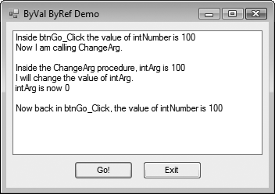
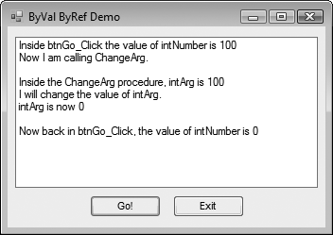
Working with ByVal and ByRef
Passing the argument ByVal
Does not change the value of intNumber
Passing the argument ByRef
Allows the value of intNumber to change

Slide 14
Functions
Section 6.3
A function returns a value to the part of the program that called the
function.

Slide 15
Declaring a Function
New keyword Function
Also new is As DataType which states the data type of the value to be returned
Return value is specified in a Return expression
[AccessSpecifier] Function FunctionName ([ParameterList]) As DataType
[Statements]
End Function

Slide 16
Function Call Example
The Sum function
Passes the variables dblValue1 and dblValue2 as arguments
Data types must agree with parameter list
Assigns the value returned by the Sum function to the variable dblTotal, agrees with return value
Tutorial 6-5 demonstrates function use
dblTotal = Sum(dblValue1, dblValue2)
Function Sum(ByVal dblNum1 As Double, ByVal dblNum2 As Double) As Double
Return dblNum1 + dblNum2
End Function

Slide 17
Returning Nonnumeric Values
Functions can return nonnumeric values, such as strings and Boolean values
strCustomer = FullName("John", "Martin")
Function FullName(ByVal strFirst As String,
ByVal strLast As String) As String
' Local variable to hold the full name
Dim strName As String
' Append the last name to the first
' name and assign the result to strName.
strName = strFirst & " " & strLast
' Return the full name.
Return strName
End Function

Slide 18
More about Debugging: Stepping Into, Over, and Out of Procedures and Functions
Section 6.4
Visual Basic debugging commands allow you to single-step through applications with procedure and function calls. The Step Into command allows you to single-step through a called procedure or function. The Step Over command allows you to execute a procedure or function call without single-stepping through its lines. The Step Out command allows you to execute all remaining lines of a procedure or function you are debugging without stepping through them.

Slide 19
The Step Into Command
The Step Into command
Continue to debug by single-stepping through a procedure
Press the F8 key
Select Debug from the menu bar, and then select Step Into from the Debug menu
Click the Step Into button on the Debug Toolbar, if the toolbar is visible
Tutorial 6-6 demonstrates the Step Into command

Slide 20
The Step Over Command
The Step Over command
Run procedure without single-stepping, continue single-step after the call
Press the Shift + F8 key
Select Debug from the menu bar, and then select Step Over from the Debug menu
Click the Step Over button on the Debug Toolbar, if the toolbar is visible
Tutorial 6-7 demonstrates the Step Over command

Slide 21
The Step Out Command
The Step Out command
End single-stepping in procedure, continue single-step after the call
Press the Ctrl + Shift + F8 key
Select Debug from the menu bar, and then select Step Out from the Debug menu
Click the Step Out button on the Debug Toolbar, if the toolbar is visible
Tutorial 6-8 demonstrates the Step Out command

Slide 22
Focus on Program Design and Problem Solving: Building the Bagel and Coffee Price Calculator Application
Section 6.5
In this section you build the Bagel and Coffee Price Calculator
application. It uses procedures and functions to calculate the total
of a customer order.

Slide 23
Introduction
The owner of Brandi’s Bagel House has asked you to write an application that her staff can use to record an order as it is called in
Customers may call in and order
White and whole wheat bagels with a variety of toppings
Three different types of coffee
The application should display
The total of the order, including 6% sales tax
Bagels:
White bagel $1.25
Whole wheat bagel $1.50
Toppings:
Cream cheese $0.50
Butter $0.25
Blueberry jam $0.75
Raspberry jam $0.75
Peach jelly $0.75
Coffee:
Regular coffee $1.25
Cappuccino $2.00
Café au lait $1.75
(Note: Delivery for coffee alone is not offered.)

Slide 24
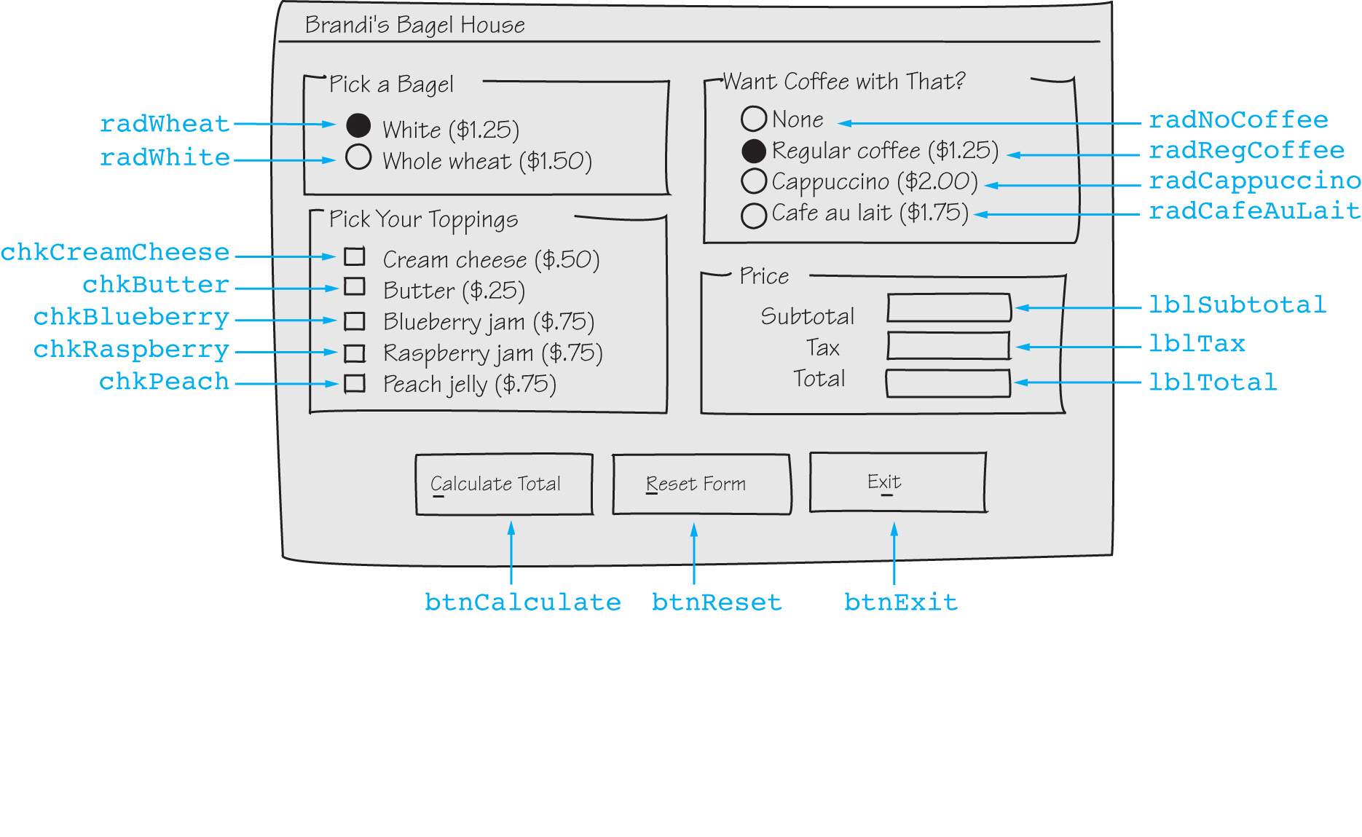
Sketch of Brandi’s Bagel House Form

Slide 25
Description of Click Event Handlers
Name | Description
btnCalculate_Click | Calculates and displays the total of an order Calls the following functions: BagelCost, CoffeeCost, ToppingCost, and CalcTax
btnExit_Click | Ends the application
btnReset_Click | Resets the controls on the form to their initial values Calls the following procedures: ResetBagels, ResetToppings, ResetCoffee, and ResetPrice

Slide 26
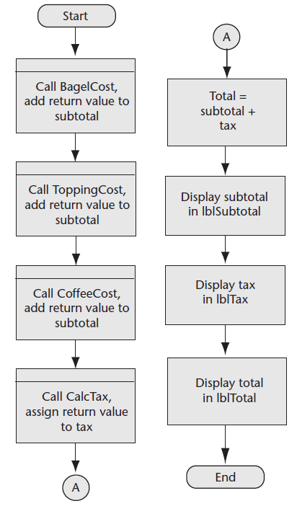
btnCalculate_Click Flowchart and Pseudocode
subtotal = BagelCost() + ToppingCost() + CoffeeCost()
tax = CalcTax(subtotal)
total = subtotal + tax
lblSubtotal.Text = subtotal
lblTax.Text = tax
lblTotal.Text = total

Slide 27
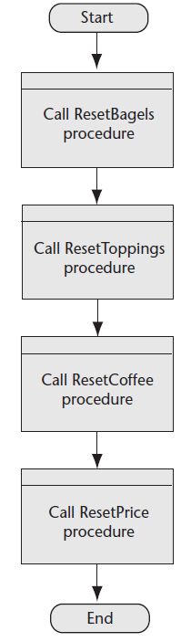
btnReset_Click Flowchart and Pseudocode
ResetBagels()
ResetToppings()
ResetCoffee()
ResetPrice()

Slide 28
Description of Functions
Name | Description
BagelCost | Returns the price of the selected bagel
ToppingCost | Returns the total price of the selected toppings
CoffeeCost | Returns the price of the selected coffee
CalcTax | Accepts the amount of a sale as an argument Returns the amount of sales tax on that amount The tax rate is stored in a class-level constant, decTAX_RATE

Slide 29
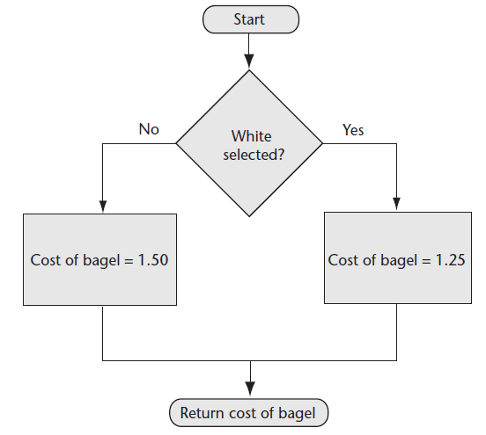
BagelCost Function Flowchart and Pseudocode
If White Is Selected Then
cost of bagel = 1.25
Else
cost of bagel = 1.5
End If
Return cost of bagel

Slide 30
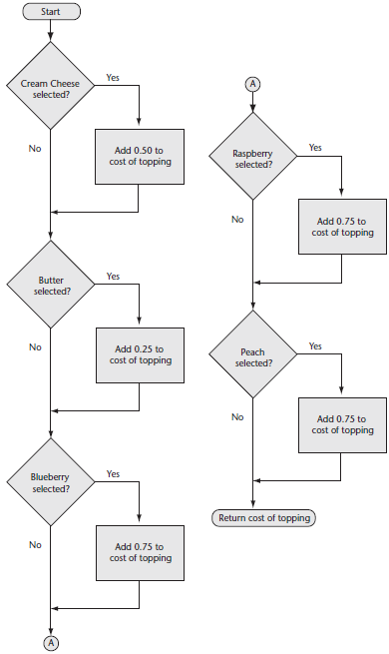
ToppingCost Function Flowchart and Pseudocode
cost of topping = 0.0
If Cream Cheese Is Selected Then
cost of topping += 0.5
End If
If Butter Is Selected Then
cost of topping += 0.25
End If
If Blueberry Is Selected Then
cost of topping += 0.75
End If
If Raspberry Is Selected Then
cost of topping += 0.75
End If
If Peach Is Selected Then
cost of topping += 0.75
End If
Return cost of topping

Slide 31
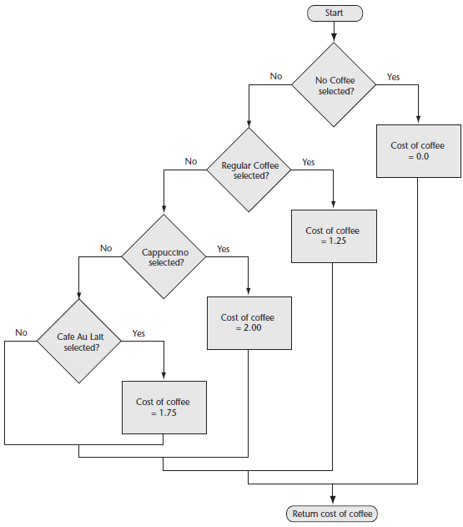
CoffeeCost Function Flowchart and Pseudocode
If No Coffee Is Selected Then
cost of coffee = 0
ElseIf Regular Coffee Is Selected Then
cost of coffee = 1.25
ElseIf Cappuccino Is Selected Then
cost of coffee = 2
ElseIf Café Au Lait Is Selected Then
cost of coffee = 1.75
End If
Return cost of coffee

Slide 32
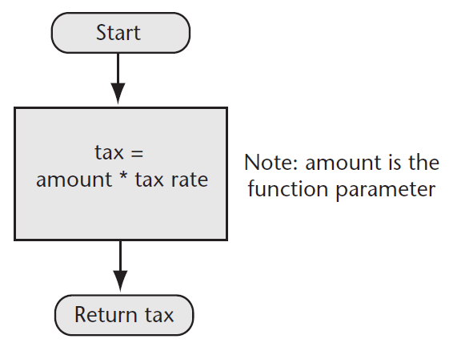
CalcTax Function Flowchart and Pseudocode
sales tax = amount * tax rate
Return sales tax

Slide 33
Description of Procedures
Name | Description
ResetBagels | Resets the bagel type radio buttons to their initial value
ResetToppings | Resets the topping check boxes to unchecked
ResetCoffee | Resets the coffee radio buttons to their initial values
ResetPrice | Sets the Text property of the lblSubtotal, lblTax, and lblTotal labels to String.Empty

Slide 34
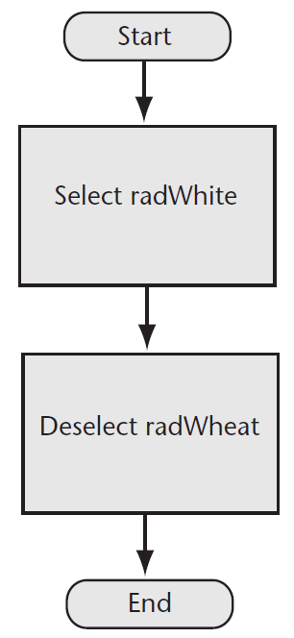
ResetBagels Procedure Flowchart and Pseudocode
radWhite = Selected
radWheat = Deselected

Slide 35
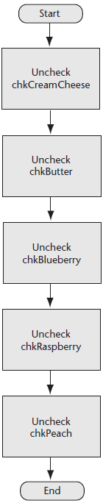
ResetToppings Procedure Flowchart and Pseudocode
chkCreamCheese = Unchecked
chkButter = Unchecked
chkBlueberry = Unchecked
chkRaspberry = Unchecked
chkPeach = Unchecked

Slide 36
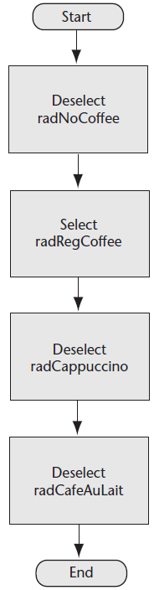
ResetCoffee Procedure Flowchart and Pseudocode
radNoCoffee = Deselected
radRegCoffee = Selected
radCappuccino = Deselected
radCafeAuLait = Deselected

Slide 37
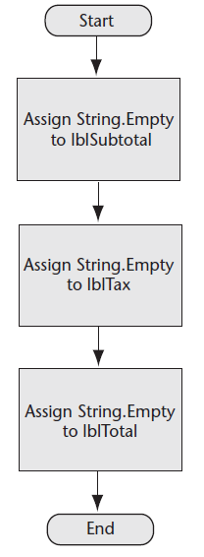
ResetPrice Procedure Flowchart and Pseudocode
lblSubtotal.Text = String.Empty
lblTax.Text = String.Empty
lblTotal.Text = String.Empty

Slide 38
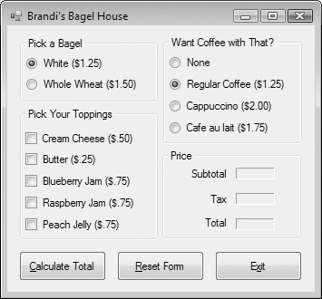
Brandi’s Bagel House Form

